Slide 1

Developing a Strategic Legal Preparation Tool
AI & Machine Learning Project
Presenter: Uma Pravallika

Slide 2
Problem Statement
Document Complexity Challenge
Manual Process Limitations
Strategic Goal
Traditional manual preparation is time-consuming, prone to human error, and may miss critical arguments buried in lengthy documents.
Extract the top 10 most pivotal arguments (both For and Against) with precise page and line references for comprehensive legal preparation.
Lawyers must analyze extensive, complex legal documents under tight deadlines, often spanning hundreds of pages with intricate legal language.

Slide 3




Project Objectives
Automate Document Analysis
Extract Critical Arguments
Transform manual legal document summarization into an efficient, AI-powered automated process that handles complex legal texts.
Identify and classify the most compelling arguments on both sides of legal issues with balanced representation.
Provide Credible References
Enhance Attorney Preparation
Ensure every extracted argument includes precise page and line citations for legal credibility and verification.
Empower legal professionals with AI-powered insights that accelerate case preparation and strategic planning.

Slide 4








Technical Approach & Methodology
Data Collection
Extract text with page/line mapping
Structure & Clean
Process and normalize legal text
Keyword Extraction
Identify critical legal terms
Sentence Scoring
Rank relevance and importance
Argument Classification
Categorize For/Against positions
Reference Mapping
Link to page/line citations
Top 10 Selection
Choose most pivotal arguments
Final Output
Generate structured summary

Slide 5
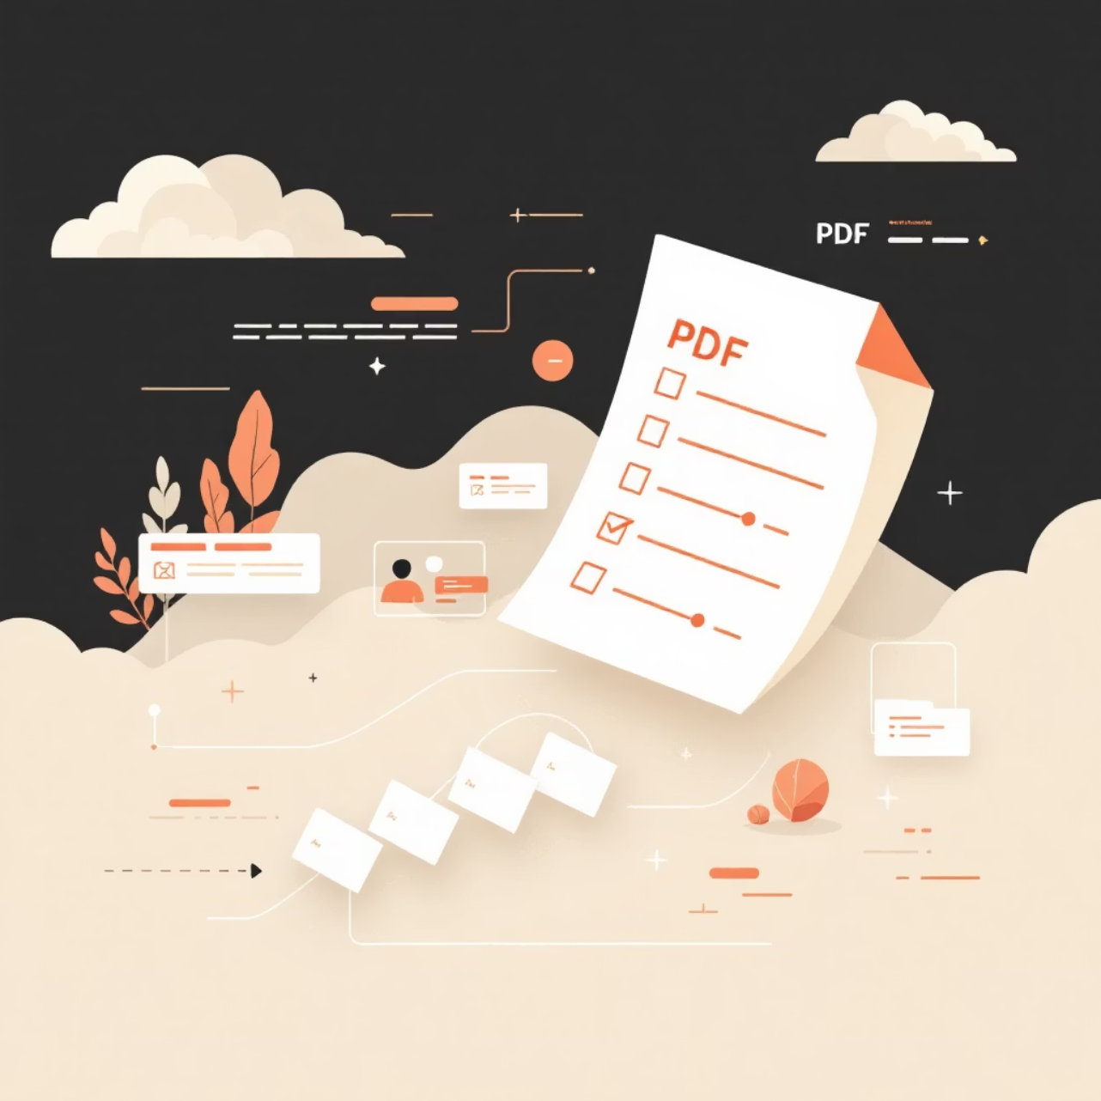
Data Collection & Preprocessing
Technical Implementation
Utilizing pdfplumber for precise extraction of legal documents, maintaining the critical relationship between content and location references.
Page-by-page text extraction with line number tracking
Structured data format: {Page, Line, Text}
NLTK-powered text cleaning and tokenization
Stopword removal while preserving legal terminology

Slide 6
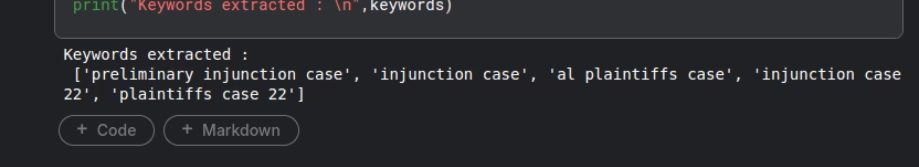

Advanced Keyword Extraction Methods
1
KeyBERT Implementation
Leverages BERT embeddings to identify semantically relevant legal keywords with contextual understanding of legal terminology.
Example Keywords: "FDA approvals", "Subpart H", "drug safety program", "regulatory compliance", "judicial review"

Slide 7
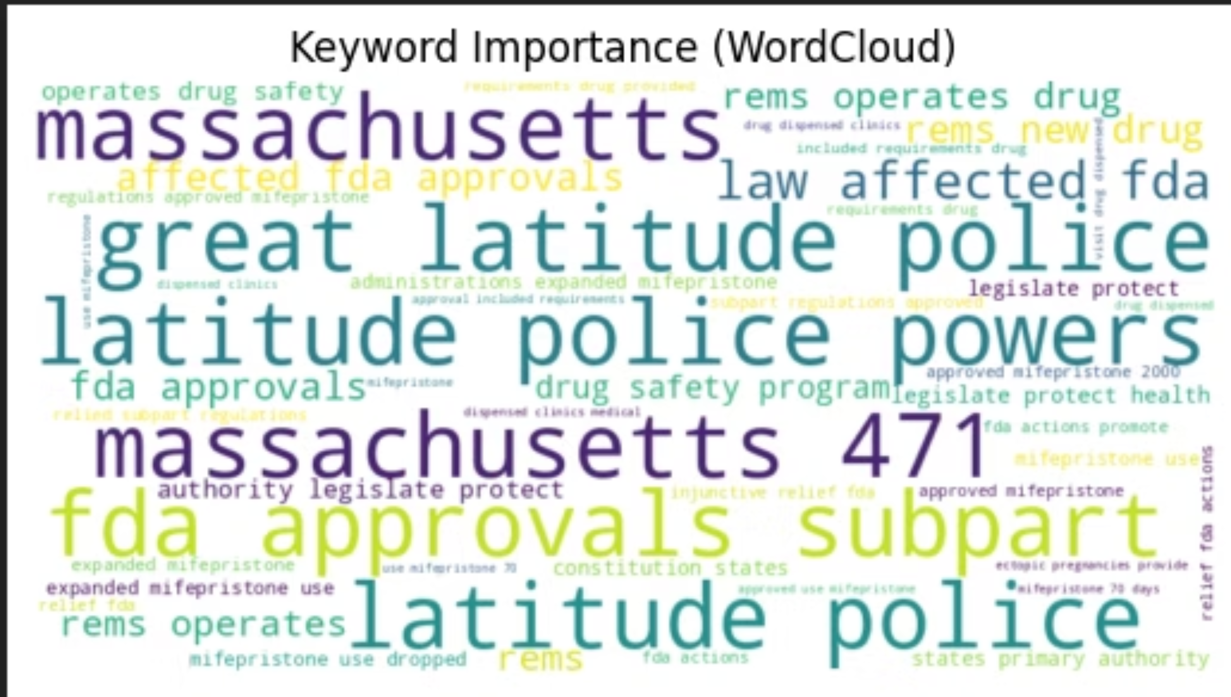

Slide 8
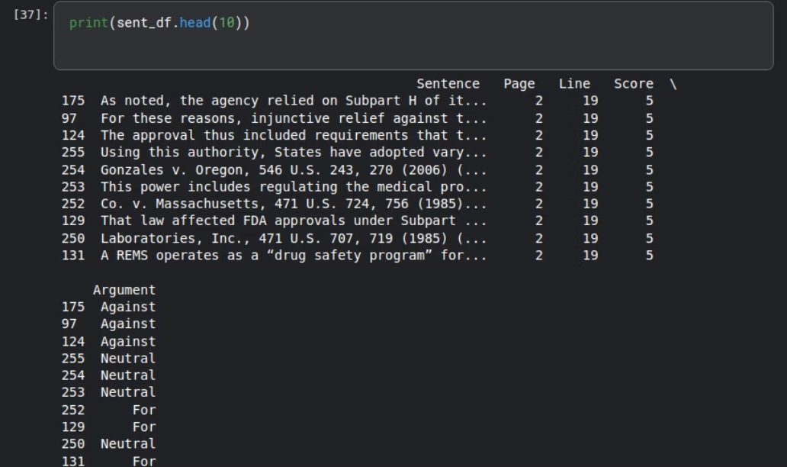

Intelligent Sentence Scoring System
Scoring Methodology
Each sentence receives a relevance score based on the density and importance of legal keywords it contains.
Higher scores indicate greater legal significance
Weighted scoring for different keyword categories
Context-aware relevance assessment

Slide 9
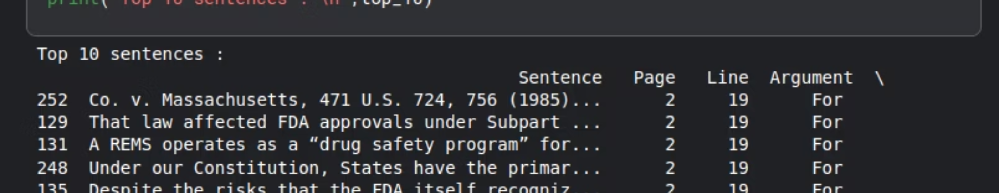
Rule-Based Argument Classification
"For" Position Keywords
"Against" Position Keywords
oppose, unlawful, violate, challenge, restrict, prohibit, unconstitutional, breach
access, ensure, promote, authorized, support, comply, legitimate, constitutional
Our sophisticated classification system ensures balanced extraction with precisely 5 "For" arguments and 5 "Against" arguments, providing comprehensive perspective coverage for thorough legal preparation.

Slide 10
Precision Reference Mapping & Results
100%
10
5:5
Citation Accuracy
Top Arguments
Balanced Analysis
Every key sentence tagged with precise page and line numbers for legal verification
Most pivotal sentences extracted and ranked by legal significance
Equal representation of "For" and "Against" legal positions

Slide 11
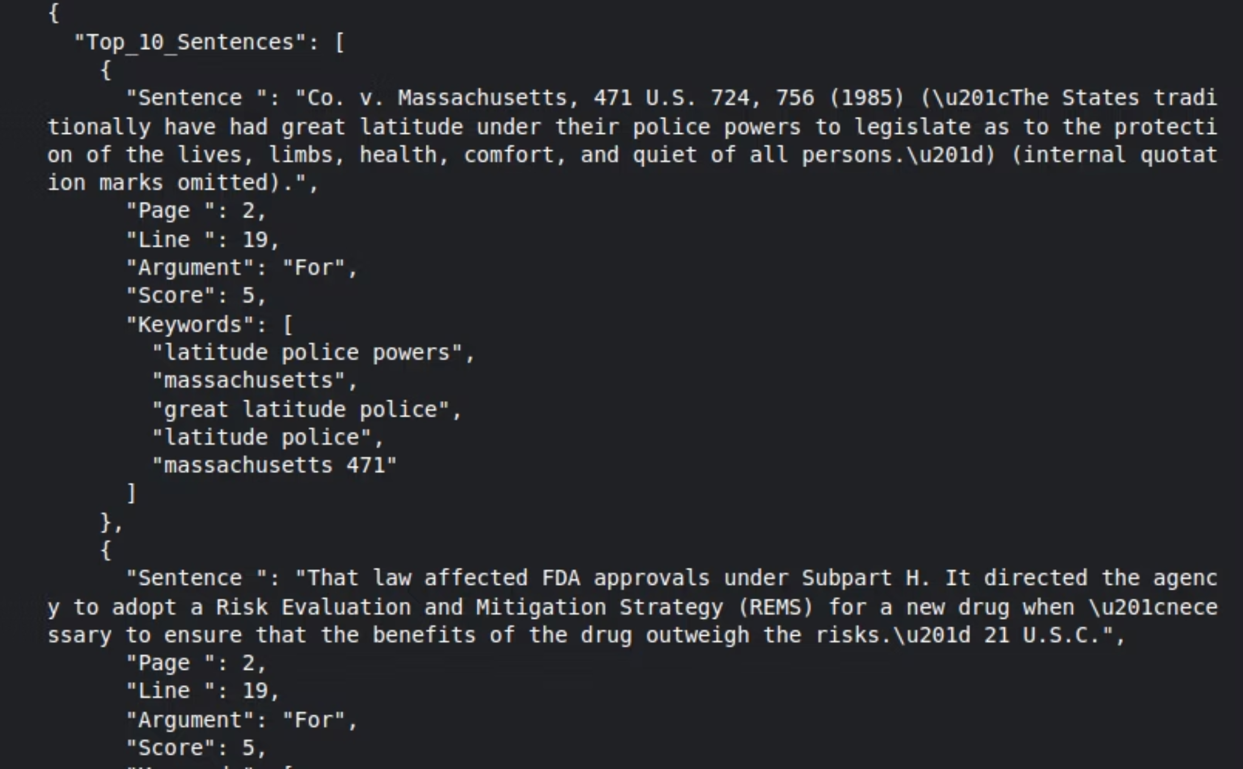

Slide 12
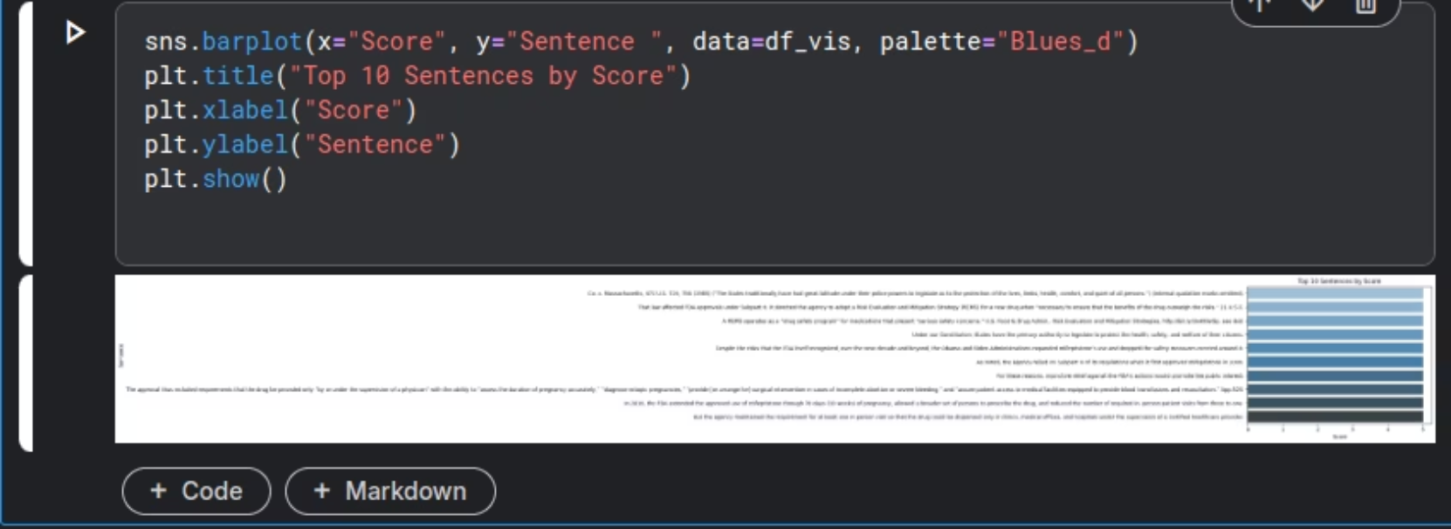
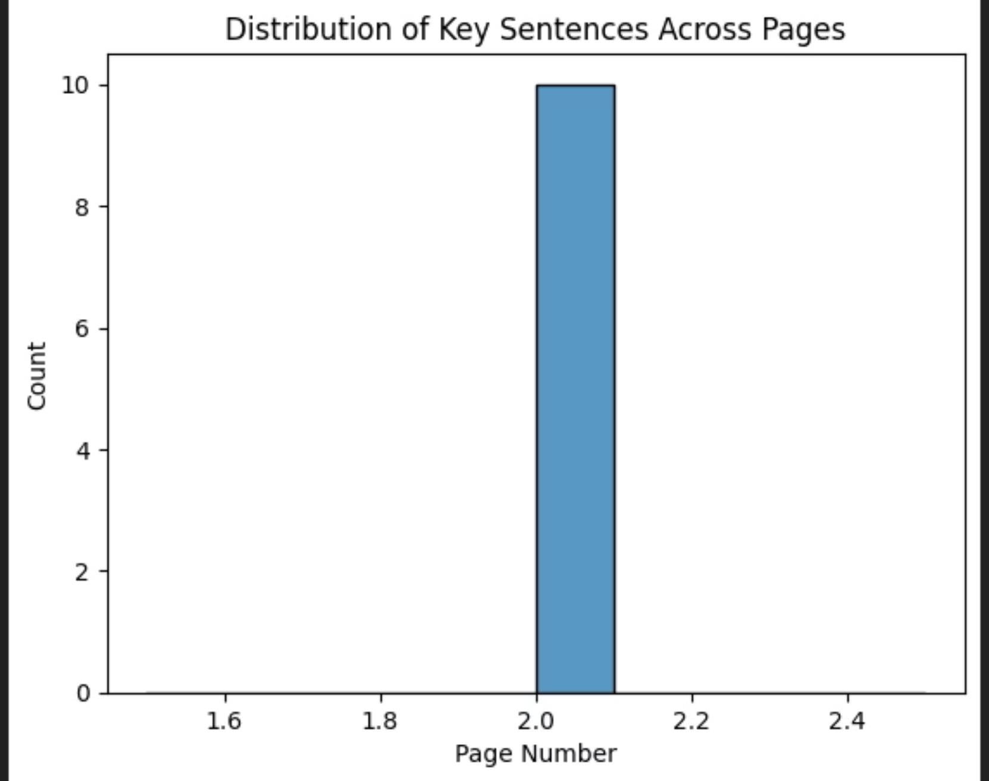
Visualizations
Bar Plot
Histogram

